Slide 1


Comprehensive Digital Marketing Project Work

Slide 2
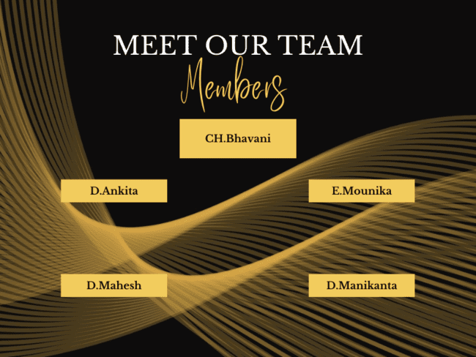

Slide 3

Part 1: Brand study, Competitor Analysis & Buyer’s/Audience’s Persona
COMPANY/TOPIC for project : Himalaya Herbal
Research Brand Identity: Study the brand's mission, values, vision, and unique selling propositions (USPs).
Industry: Pharmaceuticals Consumer goods
Logo :
Mission/Values:
"To harness the power of nature's wisdom and science to provide safe, effective, and natural herbal solutions for holistic wellness, empowering individuals to lead healthier and happier lives."

Slide 4

USP : The Unique Selling Proposition (USP) for Himalaya Herbals lies in its commitment to "Nature's Gift for Holistic Wellness." This USP differentiates Himalaya Herbals from other herbal wellness brands and highlights its core strengths:. Tagline: "Nature's Gift for Holistic Wellness"
Products : Personal care Herbal medicine Ayurvedic medicine Nutraceutical Cleaning agent Animal care
Revenue : ₹35.5 billion (US$440 million) (FY21)10,000

Slide 5
Part 1: Brand study, Competitor Analysis &Buyer’s/Audience’s Persona
Analyze Brand Messaging : Overall, Himalaya Herbals' brand messaging successfully conveys its core values, strengths, and differentiation in the herbal wellness market. The combination of nature, science, trust, and holistic well-being creates a compelling brand identity that resonates with health-conscious consumers seeking natural and effective solutions for their wellness needs.
Examine the brand’s tagline :
Himalaya Herbals' tagline, "Nature's Gift for Holistic Wellness," effectively captures the essence of the brand's philosophy and value proposition. It communicates the brand's dedication to harnessing the power of nature to provide holistic solutions for overall well-being. This tagline has played a significant role in shaping Himalaya Herbals' strong brand identity in the herbal wellness industry and resonates with health-conscious consumers seeking natural and balanced approaches to wellness.

Slide 6
Part 1: Brand study, Competitor Analysis & Buyer’s/Audience’s Persona
Competitor Analysis: Select three competitors operating in the same industry or niche as the chosen brand, examine their USPs and online communication
A comprehensive competitor analysis can provide valuable insights for Himalaya Herbals to refine its marketing strategies, identify market gaps, and capitalize on its strengths. Remember that the herbal wellness industry may have dynamic competition, so it's essential to regularly monitor competitors and adapt strategies accordingly.
Himalaya Herbals faced competition from several other media production companies in the Indian industry. Keep in mind that the competitive landscape might have evolved since then, so it's essential to conduct a fresh analysis for the most up-to-date information. Nevertheless, here are three key competitors that Himalaya Herbals might have faced:

Slide 7
Competitor 1:Patanjali Ayurveda
USP: Patanjali Ayurveda's USP lies in its promotion of natural and traditional Ayurvedic remedies. The brand emphasizes the use of ancient Ayurvedic ingredients and formulations, positioning itself as a trusted provider of authentic Ayurvedic products.
Communication: Patanjali Ayurveda's online communication focuses on Ayurvedic remedies for various health and beauty concerns. Their website, social media channels, and marketing materials highlight the natural and traditional aspect of their products. They often leverage endorsements from yoga guru Baba Ramdev to build credibility and trust among their audience.
Competitor 2: Biotique
USP: Biotique's USP centers around its use of advanced bio-technology to create Ayurvedic and plant-based products. The brand combines the best of Ayurvedic principles with modern science, offering effective and innovative herbal solutions.

Slide 8
Communication: Biotique's online communication revolves around their bio-technology approach and natural ingredients. They highlight the purity and effectiveness of their products, appealing to consumers who seek a blend of traditional remedies and scientific advancements. Their website and social media content often feature product showcases and customer testimonials
Competitor 3: Forest Essentials
USP: Forest Essentials' USP lies in its focus on luxury Ayurveda. The brand offers premium and handcrafted skincare, haircare, and wellness products using traditional Ayurvedic ingredients, catering to a more upscale audience.
Communication: Forest Essentials' online communication is elegant and luxurious, reflecting their premium positioning. Their website and social media content showcase the richness of their products, highlighting the use of rare and exotic natural ingredients. They often collaborate with influencers and promote their products as a part of self-care and indulgence routines.
Each of these brands has its unique positioning and communication strategy in the herbal wellness industry, appealing to different segments of consumers based on their preferences and needs. t industry.

Slide 9
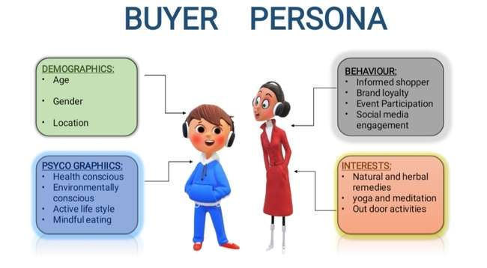
Part 1: Brand study, Competitor Analysis & Buyer’s/Audience’s Persona
Buyer's/Audience's Persona: Clearly define the target audience for the chosen brand. Consider demographics, psychographics, behaviors, and interests.
By understanding the needs, interests, and values of Health-Conscious Hannah, Himalaya Herbals can create targeted marketing campaigns that resonate with her and establish a strong emotional connection with this specific segment of their audience.

Slide 10
Demographics:
Age: Primarily targeted at the 25-35 age group, with a focus on young adults and middle-aged individuals.
Gender: Balanced appeal to female audiences, with specific content catering to each.
Location: Mainly urban and sum-urban areas across India, with some international viewership, especially in countries with a significant Indian diaspora.
Psychographics:
Health and Wellness Focused : Wendy prioritizes her health and wellness. She seeks products that contribute to her overall well-being and help her maintain a healthy and balanced lifestyle.
Stressed and Busy : With a hectic lifestyle, Wendy often experiences stress and seeks ways to relax and de-stress.
Conscious Consumer : She is an informed shopper who values quality and safety. She prefers natural and herbal products that align with her values.

Slide 11
`
Behaviors:
Proactive Approach: Wendy takes a proactive approach to her health, seeking preventive measures and natural remedies to address health concerns.
Online Research: Before making a purchase, she conducts online research, reads reviews, and compares products to make informed decisions.
Loyalty to Trusted Brands: Once she finds a brand she trusts and believes in, Wendy tends to remain loyal to that brand.
Interests:
Holistic Wellness: Wendy is interested in products that promote overall well-being, including skincare, haircare, and health supplements.
Self-Care: She enjoys self-care routines, such as skincare rituals, aromatherapy, and relaxation techniques.
Yoga and Meditation: Wendy practices yoga and meditation to manage stress and improve her mental well-being.
Targeted Messaging for Himalaya Herbals:
To resonate with Wellness Seeker Wendy, Himalaya Herbals can tailor its messaging to align with her preferences and values:

Slide 12
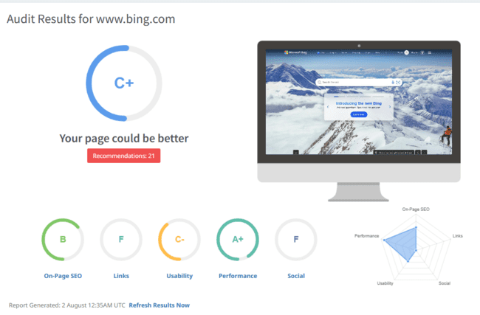
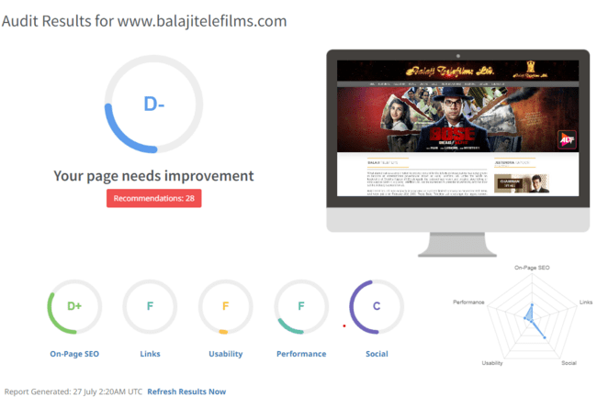
Part 2: SEO & Keyword Research
SEO Audit: Do an SEO audit of the brands website
SEO factors to consider when conducting an SEO audit for their website. You can use this checklist to evaluate the website's overall SEO health
Check Website Structure and
Navigation:
Ensure the website has a clear
and user-friendly structure with a
Logical hierarchy of pages and a
Consistent navigation menu.
Verify that essential pages like
(Home, About, Contact, etc.)
Are easily accessible.

Slide 13
On-Page SEO:
Analyze title tags and meta descriptions for relevancy and keyword optimization.
Ensure header tags (H1, H2, etc.) are appropriately used and contain relevant keywords.
Evaluate keyword usage and content relevancy in each page's content.
Check for duplicate content and implement canonical tags where needed.
Technical SEO:
Check site speed and performance.
Ensure the website is mobile-friendly and responsive.
Review URL structure and ensure it's SEO-friendly.
Check for broken links and fix any 404 errors.
Verify XML sitemap presence and accuracy.
Examine the robots.txt file for proper indexing instructions.

Slide 14
Keyword Research and Targeting: :
Review the website's content and meta tags to identify the target keywords being used.
Align keywords with the brand's offerings and target audience's search intent.
Create a content strategy around target keywords to improve organic visibility.
User Experience (UX):
Evaluate website navigation and ease of use.
Ensure clear calls-to-action (CTAs) for users to take desired actions.
Review the website's design and layout for user-friendliness.
Optimize page load times to improve user experience.
Backlink Profile:
Analyze the website's backlink profile for quality and relevance.
Disavow any toxic or spammy backlinks that could harm the website's ranking.

Slide 15
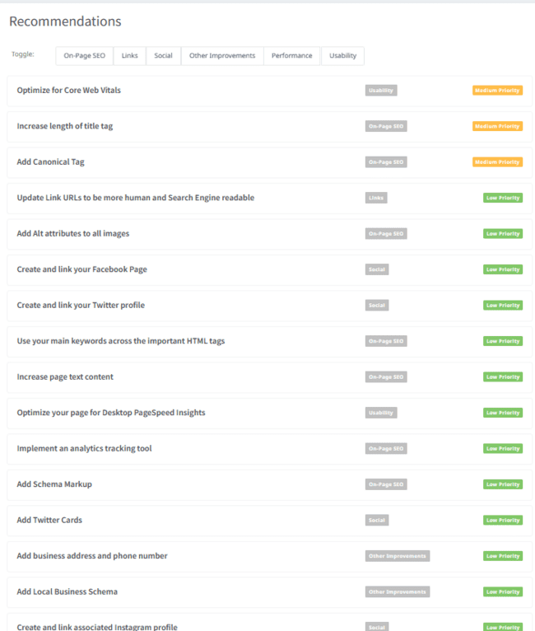
Social Media Presence:
Evaluate the brand's social media presence and engagement with the audience.
Ensure that the website's content is shareable on social media platforms.

Slide 16
Local SEO (if applicable):
Optimize Google My Business (GMB) listing with accurate business information.
Ensure consistent Name, Address, and Phone (NAP) information across the web.
Encourage positive reviews and respond to customer feedback on GMB.
Analytics and Tracking:
Set up Google Analytics to track website traffic, user behavior, and conversions.
Use Google Search Console to monitor the website's performance and indexation status.
Monitor key performance indicators (KPIs) such as organic traffic, bounce rate, and conversion rate.
Performing a comprehensive SEO audit using the checklist above will help identify areas of improvement and develop a solid SEO strategy for Himalaya Herbals' website to improve its search engine visibility and organic traffic. Keep in mind that SEO is an ongoing process, and regular monitoring and optimization are essential to maintain and enhance the website's SEO health.

Slide 17
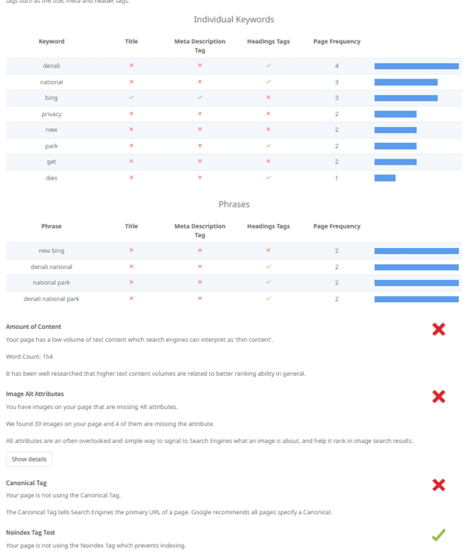
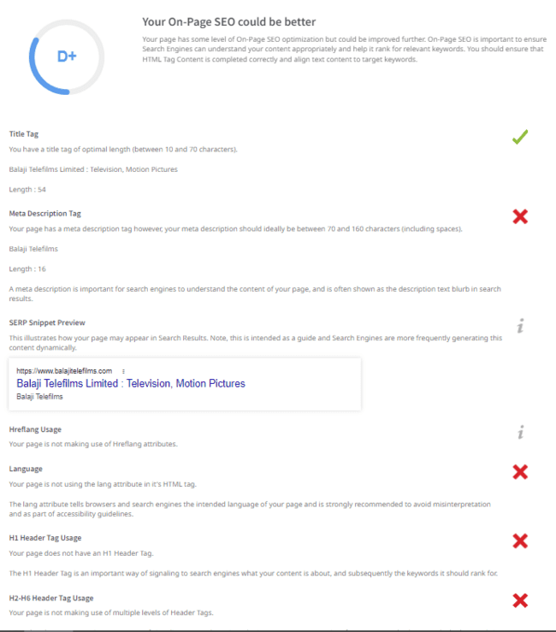

Slide 18
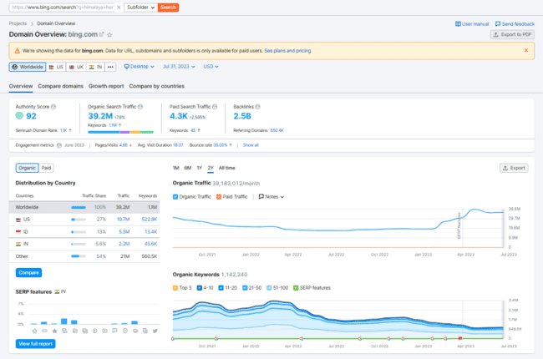
Keyword Research
Remember that keyword research is an ongoing process. Regularly monitor keyword performance, adjust strategies based on new trends, and continuously optimize the website to maintain a competitive edge in the herbal wellness industry.

Slide 19
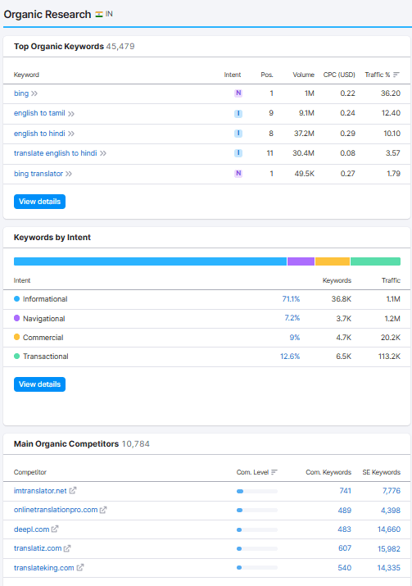
1. Research Objectives: Keyword research aims to identify relevant and high-converting keywords that align with Himalaya Herbals' products and services. The research objectives are to:
Increase organic traffic to the website.
Identify keywords with higher conversion potential.
Target specific health and wellness niches.
Optimize content and product pages for better search engine rankings.
2. Brainstorm Seed Keywords: Start with seed keywords that are broad terms related to Himalaya Herbals' offerings:
Herbal wellness
Natural skincare
Ayurvedic supplements
Holistic health
Organic beauty products
Herbal remedies
3. Utilize Keyword Research Tools: Use keyword research tools like SEMrush or Moz Keyword Explorer to expand the seed keywords and gather data on search volume, competition, and potential conversions. These tools can suggest related keywords and help identify valuable long-tail phrases.

Slide 20
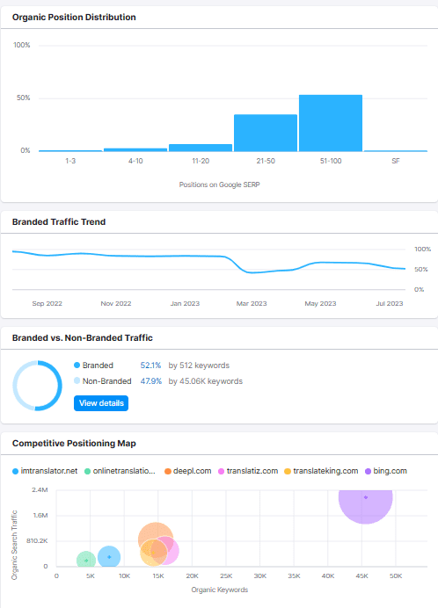
5. Long-tail Keyword Exploration: Explore long-tail keywords that have lower competition but higher conversion potential:
"Best herbal supplements for immune support“
"Natural skincare routine for sensitive skin“
"Ayurvedic hair oil for hair growth“
"Holistic wellness tips for busy professionals“
"Organic beauty products for glowing skin“
"Herbal remedies for stress relief“
6. Aligning Keywords with Objectives:
Identify keywords related to specific Himalaya Herbals products and create product-specific landing pages optimized for those keywords.
Optimize blog content with informative long-tail keywords to attract users seeking valuable information on health and wellness.
Use high-converting keywords in meta titles and descriptions to entice users to click through from search engine results.
7. Content Strategy: Create content around target keywords, addressing users' needs and providing valuable information. Offer detailed product descriptions, informative blog posts, and educational articles to engage users and showcase Himalaya Herbals as an authoritative herbal wellness brand

Slide 21
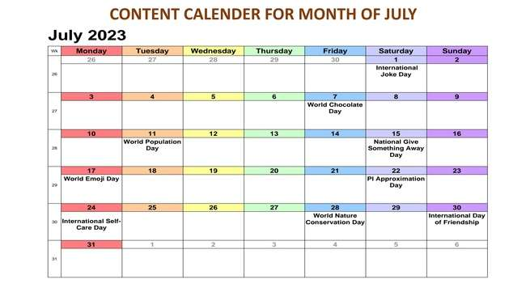
Content Calendar Example

Slide 22
Part 3: Content Ideas and Marketing Strategies
Content Calendar for July (Himalaya Herbals)
Content Theme: "Summer Wellness with Himalaya Herbals"
Week 4: July 24 - July 31
Content Formats:
Blog Posts: "7 Natural Ways to Beat the Summer Heat: Himalaya's Herbal Remedies"
Aim: Provide tips and remedies to stay cool and healthy during the hot summer months.
Idea: Share herbal solutions for common summer concerns like sunburn, dehydration, and skin care.
Videos: "DIY Herbal Face Masks for Glowing Skin"
Aim: Engage the audience with a visually appealing and informative video.
Idea: Demonstrate the process of making herbal face masks using Himalaya Herbals' products for radiant skin.
Infographics: Highlight the brand's sustainability efforts and environmental consciousness, connecting with eco-conscious consumers.

Slide 23
Content Calendar:
Week 1:
July 1: Blog Post: "The Power of Herbal Remedies: Unlocking Nature's Healing Secrets"
Aim: Educate the audience about the benefits of herbal remedies and Himalaya Herbals' commitment to natural ingredients.
Week 2:
July 8: Video: "DIY Herbal Skincare Tips for Healthy Glowing Skin"
Aim: Showcase easy-to-follow DIY skincare tips using Himalaya Herbals' products, emphasizing their natural and effective qualities.
Week 3:
July 15: Infographic: "Herbs for Immune Support: Strengthen Your Defense Naturally"
Aim: Provide a visually engaging infographic featuring herbs known for their immune-boosting properties.
Week 4:
July 22: Podcast: "Wellness Unplugged: Holistic Living and the Himalaya Herbals Story"
Aim: Share the brand's journey and values through an inspiring podcast on holistic living and wellness.

Slide 24
Week 5:
July 29: Interactive Quiz: "Discover Your Herbal Wellness Routine: Personalized Recommendations"
Aim: Engage the audience with an interactive quiz that offers personalized Himalaya Herbals' product recommendations for their wellness needs.
Additional Content:
July 9: Special Promotion: "Summer Wellness Sale: 15% Off on Select Products“ Aim: Drive sales and promote seasonal products during a limited-time offer for summer wellness.
July 30: Behind-the-Scenes: From Seed to Serum - Our Herbal Journey Aim: Offer a behind-the-scenes glimpse into Himalaya Herbals' herbal sourcing and product development process
Content Strategy and Aims: The content calendar's strategy is to position Himalaya Herbals as a holistic wellness brand that emphasizes the power of nature and herbal solutions. The aims of each content piece are:

Slide 25
Idea Behind the Content: The content ideas aim to highlight Himalaya Herbals as a brand that embraces the power of nature and offers effective herbal solutions for holistic wellness. By providing valuable, educational, and interactive content, Himalaya Herbals aims to engage its audience, nurture brand loyalty, and reinforce its position as a trusted and natural choice for health and beauty needs.
Here's a content calendar for Himalaya Herbals covering the month of August. The content themes are centered around holistic wellness, natural skincare, and promoting the brand's values and products:
Remember to use relevant hashtags for each social media holiday to increase visibility and engagement. Additionally, ensure that the content aligns with Himalaya Herbals' brand identity and resonates with the interests of their target audience.

Slide 26
Part 3: Content Ideas and Marketing Strategies
Reflect on the content ideas and marketing strategies process, discussing the challenges encountered and lessons learned.
Challenges Encountered:
Regulatory Compliance: Himalaya Herbals operates in various countries with different regulations, which can pose challenges in terms of product claims and advertising guidelines.
Competitive Market: The herbal wellness industry is competitive, and standing out among other well-established brands requires a unique and compelling marketing strategy.
Consumer Education: Educating the audience about the benefits of herbal remedies and Ayurveda might require additional efforts, especially in regions where traditional medicine is less familiar.
Social Media Algorithm Changes: Keeping up with social media platform algorithms and ensuring content reaches the target audience organically can be challenging.
Resource Constraints: Allocating sufficient resources for content creation, influencer collaborations, and marketing campaigns may be limited, especially for smaller marketing teams.

Slide 27
2. Lessons Learned:
Customer-Centric Approach: Prioritize customer needs and preferences in content creation and marketing strategies to build meaningful connections with the audience.
Data-Driven Decisions: Use data and analytics to track the performance of content and marketing efforts, identifying what resonates best with the audience.
Consistency and Authenticity: Consistent branding and authentic messaging help in building trust and credibility with the audience.
Flexibility and Adaptability: Stay flexible and adapt to changes in the industry, consumer behavior, and social media platforms' algorithms.
Long-Term Relationship Building: Focus on cultivating long-term relationships with customers through engaging content and personalized communication.

Slide 28
Content Ideas:
Herbal Wellness Guides: Create comprehensive guides on different aspects of herbal wellness, such as "Herbal Remedies for Common Ailments" or "Herbs for Stress Relief.“
User-Generated Content Campaign: Encourage customers to share their Himalaya Herbals' experiences through reviews, testimonials, and before-and-after photos.
Educational Video Series: Develop a series of short videos featuring experts discussing various health topics and how herbal remedies can support overall well-being.
Seasonal Skincare Tips: Offer seasonal skincare tips and routines using Himalaya Herbals' products to address specific skin concerns during different weather conditions.
Behind-the-Scenes Content: Showcase the brand's sustainable sourcing efforts, manufacturing processes, and quality control measures to build trust with the audience.

Slide 29
Marketing Strategies:
Influencer Collaborations: Partner with influencers and wellness experts to promote Himalaya Herbals' products and showcase their benefits to a wider audience.
Social Media Contests: Organize contests and giveaways on Facebook and Instagram to increase brand visibility and engage with followers.
Email Marketing: Utilize email campaigns to share valuable content, exclusive offers, and product updates with a segmented audience.
SEO and Content Optimization: Focus on keyword research and content optimization to improve organic search rankings and drive targeted traffic to the website.
Cross-Platform Promotion: Ensure consistent branding and messaging across all marketing channels to strengthen brand identity and recognition.

Slide 30
Part 4: Content Creation and Curation (Post creations, Designs/Video Editing, Ad Campaigns over Social Media and Email Ideation and Creation)
Post Creation: Select Content Categories: Identify three different content formats relevant to the chosen topic or industry. Research and Brainstorm: Research trending topics, industry news, or audience interests within each category. Brainstorm ideas for social media posts that align with each category. Do note that 1 content format has to be video and additionally 3 stories/status are to be created.
Content Categories and Formats:
Educational Video:
Create a short educational video on "The Power of Ayurvedic Herbs for Natural Skincare.“
Video will showcase the benefits of Himalaya Herbals' herbal skincare products, featuring key natural ingredients and their properties.
The aim is to educate the audience about the brand's skincare range and its reliance on traditional Ayurvedic knowledge.

Slide 31
Format 1
Inspirational Quote Image:
Design an eye-catching image featuring an inspirational wellness quote like "Nature is the Best Healer, Embrace its Gifts!“
This post will align with the brand's emphasis on nature's healing power and encourage a positive mindset towards holistic wellness.
Format 1
User-Generated Content (UGC) Campaign:
Encourage followers to share their "Favorite Himalaya Herbals' Product" with a testimonial or photo using a branded hashtag (#MyHerbalsFavs).
Repurpose user-generated content to showcase real-life experiences and reviews from satisfied customers.
Format 1
User-Generated Content (UGC) Campaign:
Encourage followers to share their "Favorite Himalaya Herbals' Product" with a testimonial or photo using a branded hashtag (#MyHerbalsFavs).
Repurpose user-generated content to showcase real-life experiences and reviews from satisfied customers.

Slide 32
Research and Brainstorm:
Educational Video:
Research trending Ayurvedic skincare ingredients and their benefits in the beauty industry.
Brainstorm script ideas that highlight specific Himalaya Herbals' products and how they address common skin concerns naturally.
Inspirational Quote Image:
Research popular wellness quotes related to nature, healing, and self-care.
Choose a quote that aligns with Himalaya Herbals' brand messaging and resonates with the audience.
UGC Campaign:
Research best practices for running successful UGC campaigns on social media platforms.
Brainstorm creative ways to encourage participation and engagement, such as offering incentives or featuring selected entries in future posts

Slide 33
Social Media and Email Ideation and Creation:
Social Media Post 1 (Educational Video):
Caption: "Discover the magic of Ayurvedic herbs in our skincare! 🌿✨ Watch our video to unveil the secret to radiant and healthy skin naturally. #AyurvedicSkincare #HimalayaHerbals“
Platforms: Facebook, Instagram, YouTube.
Social Media Post 2 (Inspirational Quote Image):
Caption: "Nature has bestowed us with incredible healing gifts. Embrace the power of nature for holistic wellness. 🌱💚 #NaturalHealing #WellnessJourney #HimalayaHerbals"
Platforms: Facebook, Instagram, Twitter.
Social Media Post 3 (UGC Campaign):
Caption: "Our beloved customers know best! Share your favorite Himalaya Herbals' product and stand a chance to be featured! Don't forget to use #MyHerbalsFavs. 📸💖 #UserGeneratedContent #HerbalWellness“
Platforms: Facebook, Instagram, Twitter.

Slide 34
Social Media Stories/Status (3):
Stories 1: Showcase a behind-the-scenes glimpse of the herbal sourcing process at Himalaya Herbals.
Stories 2: Tease a new upcoming herbal product launch, creating excitement among followers.
Stories 3: Run a poll asking followers to vote for their favorite Himalaya Herbals' skincare range.
Email Campaign:
Subject: "Embrace the Power of Ayurveda for Glowing Skin!“
Content: Include a snippet of the educational video and invite subscribers to watch the full video on the website. Promote the UGC campaign and encourage participation for a chance to be featured. Offer exclusive discounts for subscribers on selected herbal skincare products.

Slide 35
Post Creation:
Format 1: Video
Content Category: "Skincare Routine Tips"
Research: Identify trending skincare tips and natural remedies for common skin concerns.
Brainstorm:
Video: "Morning Skincare Routine for a Fresh Start"
Showcase a step-by-step morning skincare routine using Himalaya Herbals' products, highlighting the natural ingredients and their benefits.
Video: "Nighttime Skincare Ritual for Beautiful Skin"
Feature an evening skincare routine that emphasizes the importance of nourishing the skin while sleeping, promoting relaxation and rejuvenation.

Slide 36
Format 2: Carousel Post
Content Category: "Herbal Ingredients Spotlight"
Research: Identify popular herbal ingredients used in Himalaya Herbals' products.
Brainstorm:
Carousel Post: "The Magic of Turmeric: An Herbal Wonder"
Create a carousel post featuring images and information about the benefits of turmeric in skincare, focusing on one product that includes this ingredient.
Carousel Post: "Neem - Nature's Cleanser for Clear Skin"
Highlight the cleansing properties of neem in a carousel post, showcasing Himalaya Herbals' neem-based product range.

Slide 37
Format 3: Instagram Stories/Status
Content Category: "Customer Testimonials"
Research: Collect positive customer feedback, reviews, and testimonials about Himalaya Herbals' products.
Brainstorm:
Story 1: Share a heartwarming testimonial from a satisfied customer, along with their photo using the product.
Story 2: Feature a before-and-after story/status of a customer who experienced visible improvements in their skin after using Himalaya Herbals' skincare.
Story 3: Encourage followers to share their Himalaya Herbals' success stories, testimonials, or product experiences using a branded hashtag (#HerbalsHappy).

Slide 38
Part 4: Content Creation and Curation (Post creations, Designs/Video Editing, Ad Campaigns over Social Media and Email Ideation and Creation)
Instagram Story
Sample Plan for Himalaya Herbals' Instagram Stories:
Highlight 3: "Behind the Scenes": This highlight will include all the behind-the-scenes glimpses shared during the three days.
Day 1:
Behind-the-scenes glimpse: Showcase the process of creating one of their popular herbal products.
Poll: Ask the audience which Himalaya Herbals product they would like to see featured in the next story.
Quiz: Create a fun quiz related to herbal remedies or natural ingredients

Slide 39
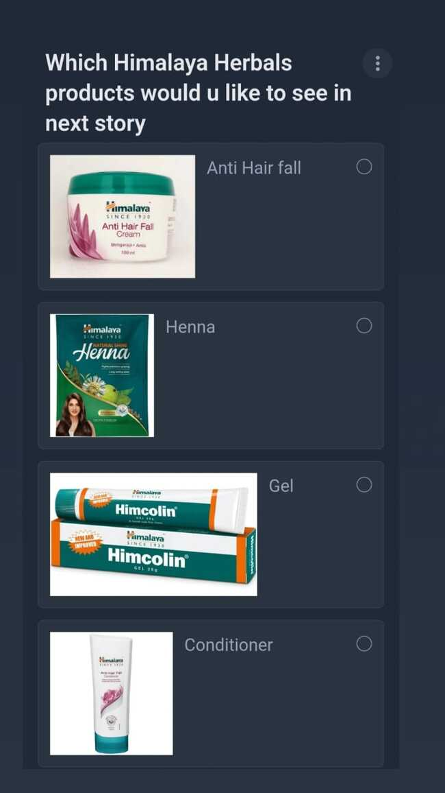
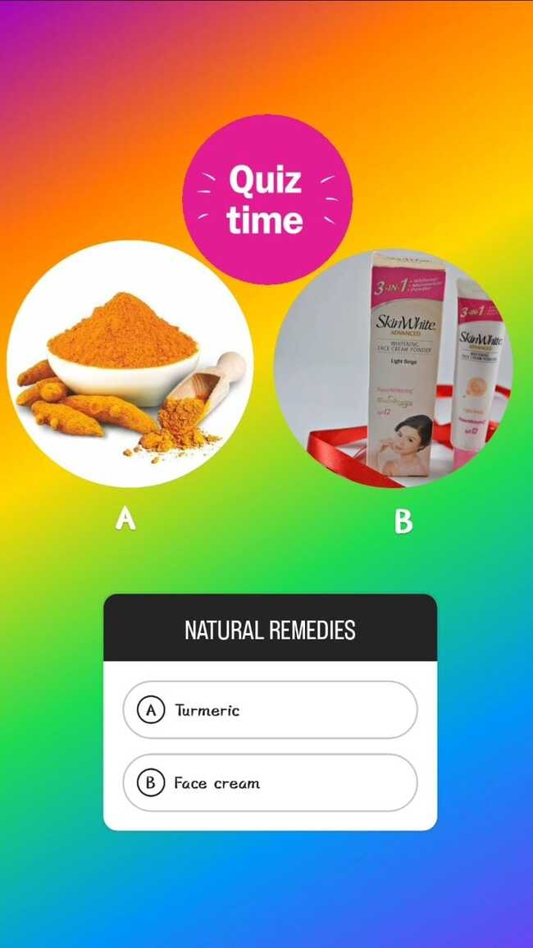

Slide 40
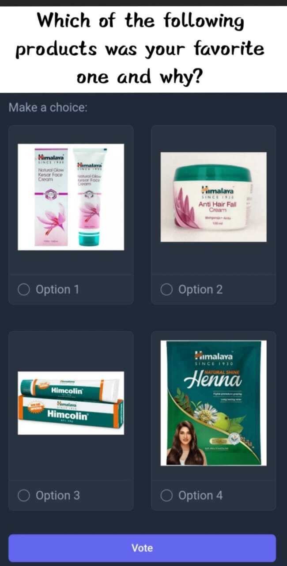
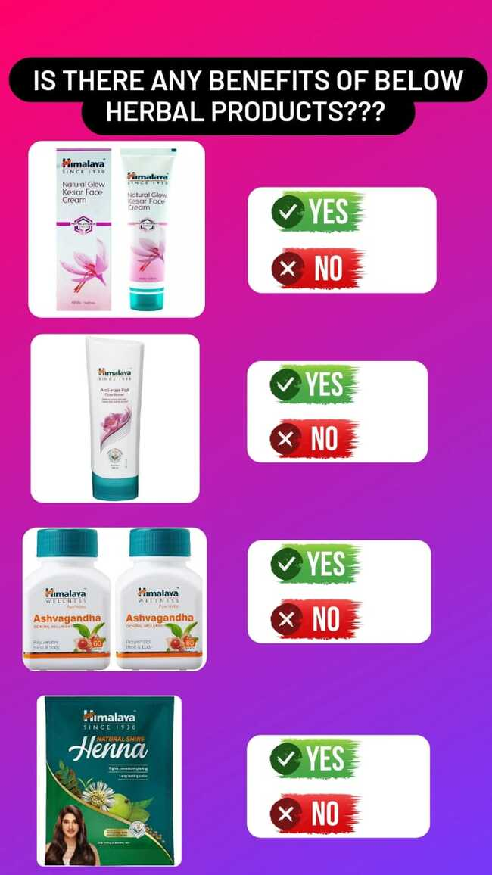
Highlight 2: "Polls & Quizzes": This highlight will feature all the interactive polls and quizzes posted for audience participation.
Day 2:
Sneak Peek: Offer a sneak peek of an upcoming product launch or an exciting event.
Poll: Ask the audience about their favorite Himalaya Herbals product and why.
Quiz: Create a quiz to test their knowledge about the benefits of specific herbal ingredients used in Himalaya Herbals products.

Slide 41
Highlight 3: "Sneak Peeks & Team": This highlight will have sneak peeks and any content related to the Himalaya Herbals team
Day 3:
Behind-the-scenes glimpse: Introduce some of the team members who are dedicated to creating the best herbal products.
Poll: Ask the audience about their preferred way of using Himalaya Herbals products (e.g., skincare routine, haircare routine, etc.).
Quiz: Create a quiz to test their knowledge of Himalaya Herbals' sustainability efforts and commitment to the environment.

Slide 42
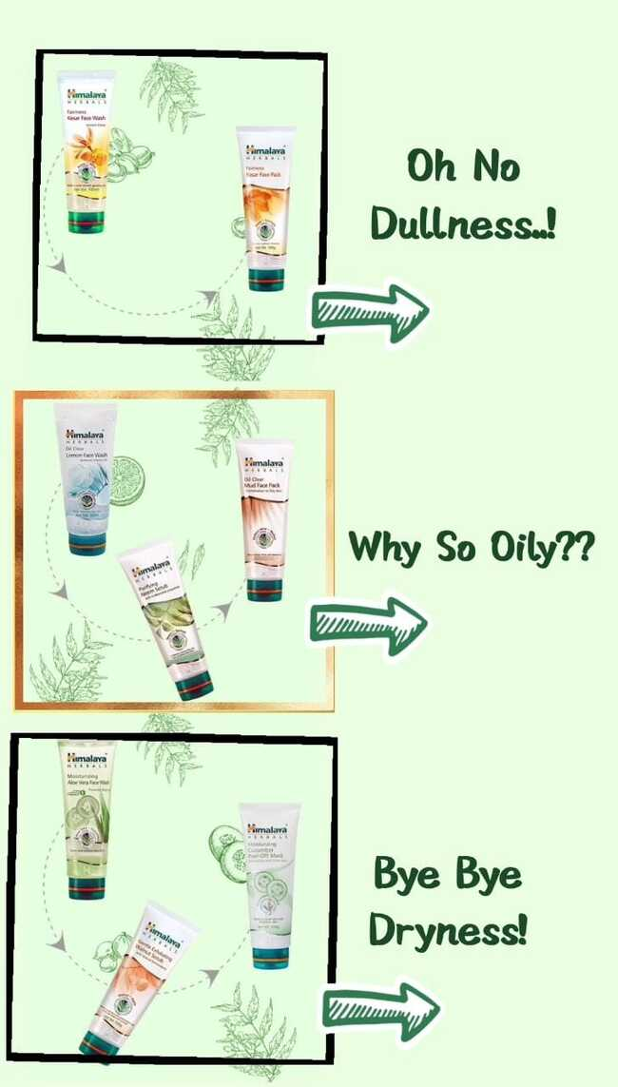
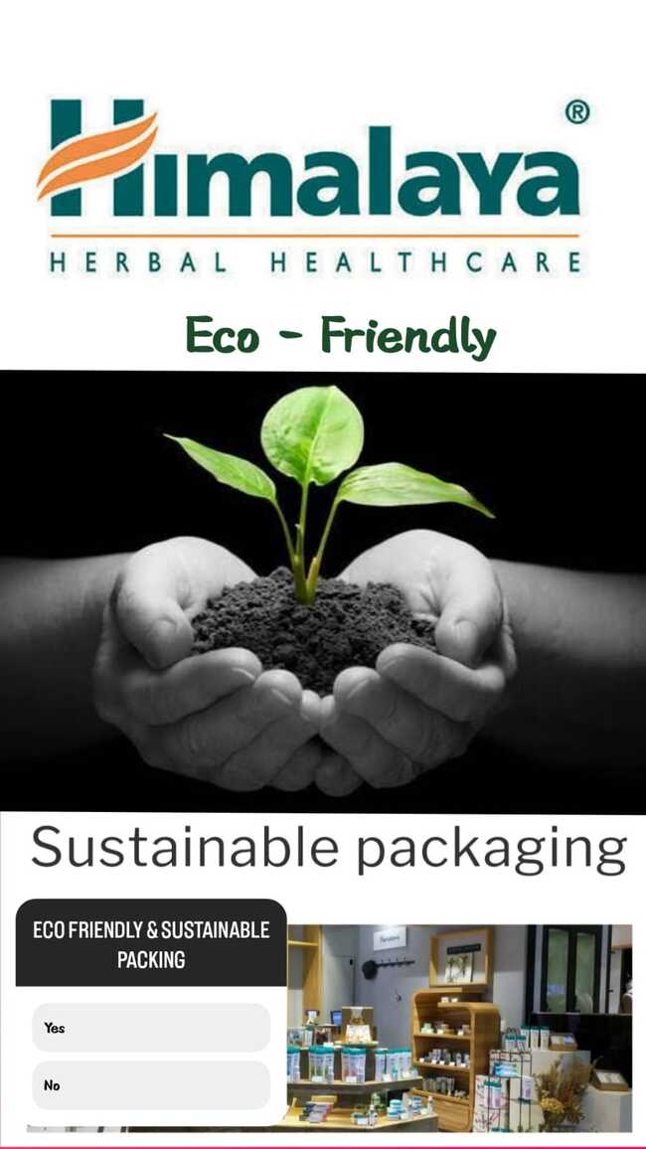

Slide 43

Part 4: Content Creation and Curation (Post creations, Designs/Video Editing, Ad Campaigns over Social Media and Email Ideation and Creation)
Designs/Video Editing

Slide 44
Part 4: Content Creation and Curation (Post creations, Designs/Video Editing, Ad Campaigns over Social Media and Email Ideation and Creation)
Ad Campaigns over Social Media: 3 ad campaigns:
Ad Campaign 1: Increasing Brand Awareness
Advertising Goals: The primary goal of this ad campaign is to increase brand awareness for Himalaya Herbals among individuals interested in natural skincare and herbal wellness.
Audience Targeting:
Demographics: Women aged 25-45, interested in beauty, skincare, and wellness.
Interests: Followers of wellness and beauty influencers, users who engage with natural skincare content.
Behavior: Individuals who have shown interest in herbal remedies, organic products, and holistic health.
Ad Creation:
Visual: An image showcasing a diverse group of women using Himalaya Herbals' skincare products with radiant skin and a happy expression.
Ad Copy: "Unveil Your Natural Radiance with Himalaya Herbals! 🌿✨ Discover the power of nature in our herbal skincare range. Embrace the beauty of natural ingredients for a glowing you! #NatureInspired #HerbalWellness #HimalayaHerbals"
Call-to-Action (CTA): "Learn More" - Redirect users to Himalaya Herbals' website to explore the product range and brand values.

Slide 45
Ad Campaign 2: Driving Website Traffic
Advertising Goals: The objective of this ad campaign is to drive targeted traffic to Himalaya Herbals' website and encourage users to explore the products.
Audience Targeting:
Demographics: Men and women aged 18-50 interested in natural skincare, herbal products, and health supplements.
Interests: Followers of health and wellness pages, yoga enthusiasts, and those interested in Ayurveda.
Behavior: People who have visited Himalaya Herbals' website in the past or engaged with the brand's social media posts.
Ad Creation:
Visual: A carousel ad featuring different product categories such as skincare, haircare, and wellness supplements.
Ad Copy: "Unlock the Secrets of Herbal Wellness with Himalaya Herbals! 🌱💚 Explore our range of natural products for your everyday well-being. Discover the best of nature for a healthier you! #HerbalWellness #DiscoverNature #HimalayaHerbals"
Call-to-Action (CTA): "Shop Now" - Encourage users to click on the ad and visit the website to explore and make a purchase.

Slide 46
Ad Campaign 3: Generating Leads
Advertising Goals: The goal of this ad campaign is to generate leads by collecting email addresses of potential customers interested in herbal wellness and skincare.
Audience Targeting:
Demographics: Men and women aged 18-40 interested in natural skincare, wellness, and organic products.
Interests: Followers of wellness blogs, fitness enthusiasts, and individuals interested in plant-based lifestyles.
Behavior: Users who have engaged with Himalaya Herbals' email sign-up forms or expressed interest in similar brands.
Ad Creation:
Visual: A visually appealing ad featuring the Himalaya Herbals logo and a compelling offer such as "Free Herbal Skincare Guide."
Ad Copy: "Claim Your FREE Herbal Skincare Guide! 🌿📗 Sign up now and receive exclusive tips for a naturally glowing you. Join our community of herbal wellness enthusiasts! #HerbalSkincareGuide #NaturalGlow #HimalayaHerbals"
Call-to-Action (CTA): "Sign Up" - Encourage users to provide their email address to access the free guide and join the brand's mailing list.

Slide 47
Part 4: Content Creation and Curation (Post creations, Designs/Video Editing, Ad Campaigns over Social Media and Email Ideation and Creation)
Email Ad Campaigns :
generationhimalayaherbals@gmail.com
brandawarenesshimalayaherbals@gmail.com

Slide 48
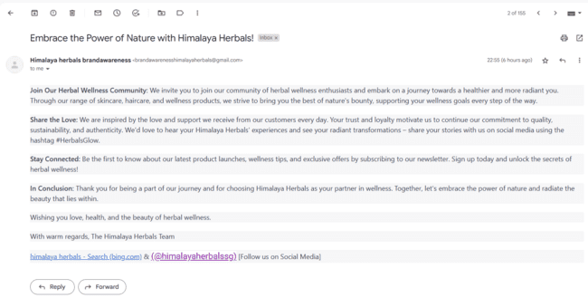
Email Ad Campaign 1 - brandawareness (insert emailer image)

Slide 49
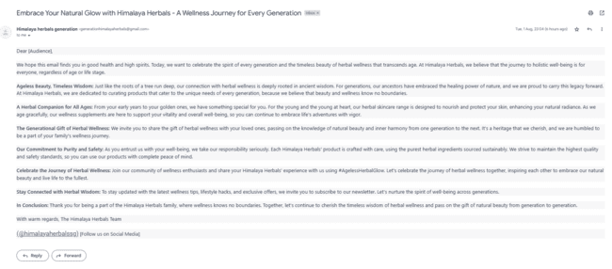
Email Ad Campaign 2 - Lead Generation (insert emailer image)

Slide 50
Part 4: Content Creation and Curation (Post creations, Designs/Video Editing, Ad Campaigns over Social Media and Email Ideation and Creation)
Reflect on the content creation and curation process, discussing the challenges faced and lessons learned.
The content creation and curation process for Himalaya Herbals was an exciting and insightful journey that aimed to connect with the audience, promote herbal wellness, and showcase the brand's values. While the process brought about several successes, there were also challenges and valuable lessons learned along the way.:
Challenges Faced:
Balancing Education and Engagement: One challenge was striking the right balance between providing educational content about herbal wellness and creating engaging, visually appealing posts. Ensuring that informative content remained interesting and shareable was a constant consideration.
Visual Consistency: Maintaining a consistent visual theme across different content formats and platforms proved challenging. Adhering to brand colors, style, and tone while adapting to various content types required careful planning and design.
Generating User-Generated Content (UGC): Encouraging users to contribute UGC required extra effort in terms of outreach, communication, and incentive planning. It took time to build trust and motivate users to share their experiences with Himalaya Herbals' products.

Slide 51
Lessons Learned:
Know Your Audience: Understanding the target audience's preferences, pain points, and interests was key to creating content that resonated with them. Regularly analyzing engagement metrics helped refine content strategies based on audience response.
Diverse Content Formats: Embracing diverse content formats, such as videos, carousels, and stories, enabled us to cater to different audience preferences and enhance engagement. Variety kept the audience engaged and excited for what was coming next.
Storytelling and Authenticity: Sharing behind-the-scenes glimpses, user testimonials, and brand stories allowed us to connect on a personal level. Authentic storytelling helped build trust and emotional connections with the audience.
Consistent Posting Schedule: Establishing a consistent posting schedule helped maintain audience interest and engagement. Regular updates kept the brand top of mind and encouraged audience interaction.
User Participation: Running contests, challenges, and user-generated content campaigns provided an opportunity for meaningful interaction with the audience. It highlighted the importance of involving users and making them feel like an integral part of the brand.
In conclusion, the content creation and curation process for Himalaya Herbals provided valuable insights into effectively communicating brand values, promoting herbal wellness, and engaging with a diverse audience. The challenges faced were opportunities for growth, and the lessons learned laid the foundation for continuous improvement in future content strategies. The journey emphasized the importance of audience understanding, creative diversity, and the power of authentic storytelling in building a strong brand presence.

Slide 52


